Slide 1
Design Methods for Unmanned Vehicles
Final Project

Slide 2
Overview
Challenge Statement
Project Work:
SLAM and Point Cloud Reconstruction
Multi-robot and Point Clouds Merging
Exploration Strategy
Path Planning
Demo
Notes:
…. Ma:
Abbiamo parlato a lungo di trovare un approccio per fare SLAM e Mapping insieme ma con una rgbd è veramente tosto scrivere
un codice efficiente per fare ciò. Dani ci ha provato a fare ICP ma…
Siamo rimasti in 2.
Sarebbe bello laurearsi.

Slide 3
Challenge Statement
UGV equipped with a RGB-D camera:
SLAM and point cloud reconstruction.
Navigation with waypoints (QR Codes).
Possibly, deployment of multiple agents, and merging of individual maps.
Notes:
…. Ma:
Abbiamo parlato a lungo di trovare un approccio per fare SLAM e Mapping insieme ma con una rgbd è veramente tosto scrivere
un codice efficiente per fare ciò. Dani ci ha provato a fare ICP ma…
Siamo rimasti in 2.
Sarebbe bello laurearsi.

Slide 4
Project Work
Multi-robot exploration, navigation and mapping:
SLAM and point cloud solution via RTAB-Map
Merging of multiple Robot Point Clouds
Autonomous Exploration Strategy
Path Planning and Control

Slide 5
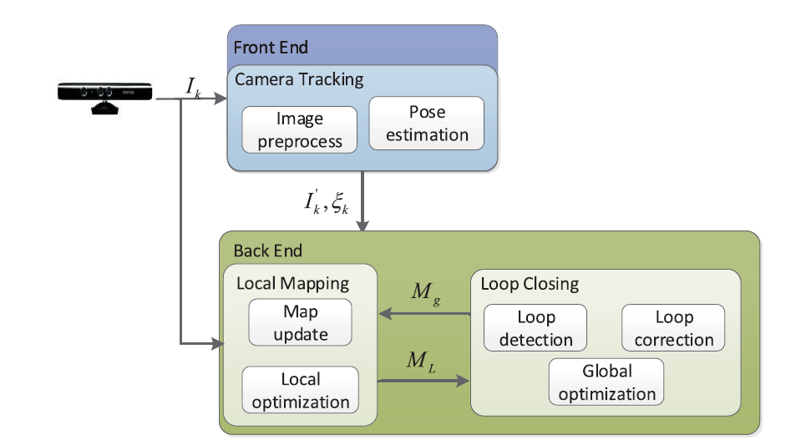
SLAM and Point Cloud Reconstrunction with RGB-D
Very expensive computation → hard to develop efficient, real-time solution.
Courtesy of Zhang, Shishun and Zheng, Longyu and Tao, Wenbing
Notes:
https://dev.intelrealsense.com/docs/stereo-depth-cameras-for-phones

Slide 6
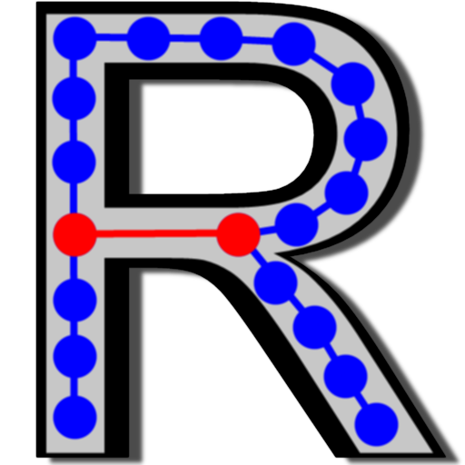
RTAB-Map
Basic project’s requirements:
Online
Point Cloud handling
Robust visual localization
Occupancy grid for navigation
Graph and Visual Slam approach
Nodes: odometry pose, raw images, visual worlds (Loop Closure)
Links: rigid transformation between nodes
Neighbour: ICP for link refinement
Loop Closure: visual bag‐of‐words approach
Real-Time Appearance-Based Mapping

Slide 7
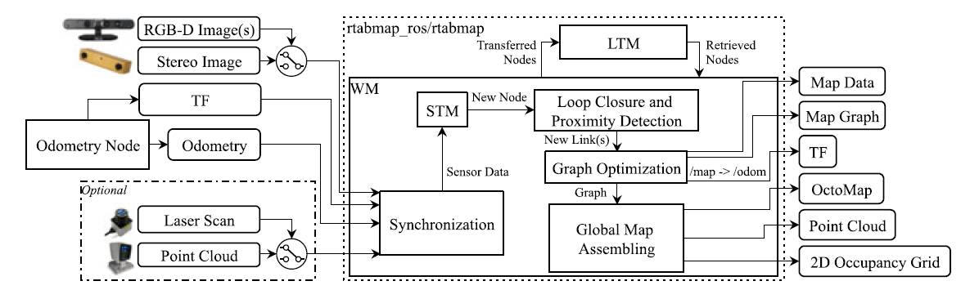
RTAB-Map
Courtesy of RTAB-Map
Notes:
https://introlab.3it.usherbrooke.ca/mediawiki-introlab/images/7/7a/Labbe18JFR_preprint.pdf

Slide 8
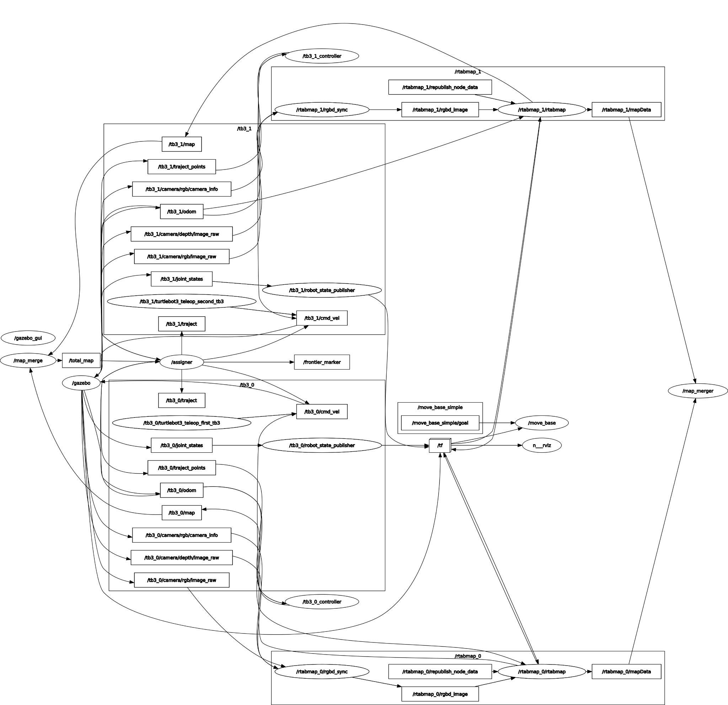
Multi robot handling

Slide 9
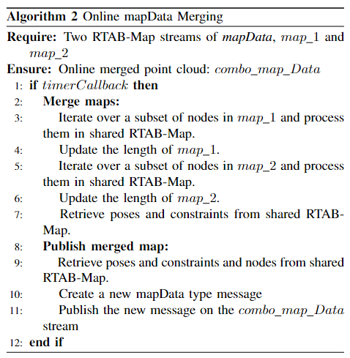
Point cloud merging with RTAB-Map
PRO:
Leverage node and bag of words approach
2 instances publishing mapData
1 dummy instance merging
Instant visualization
Creation of .db files (start where you left approach)
CONS:
Dependent on RTAB-Map env
Clusters of points from multiple registrations

Slide 10
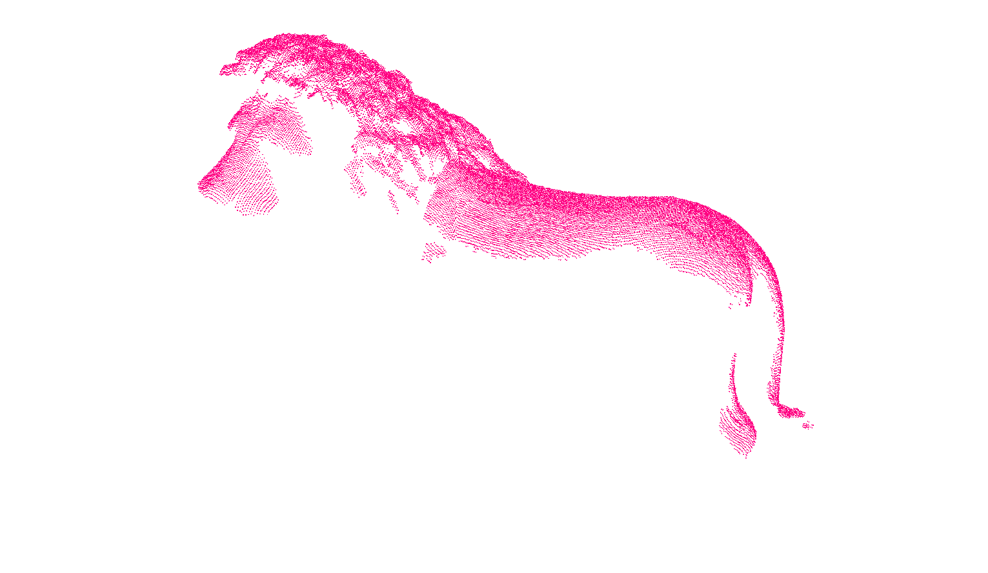
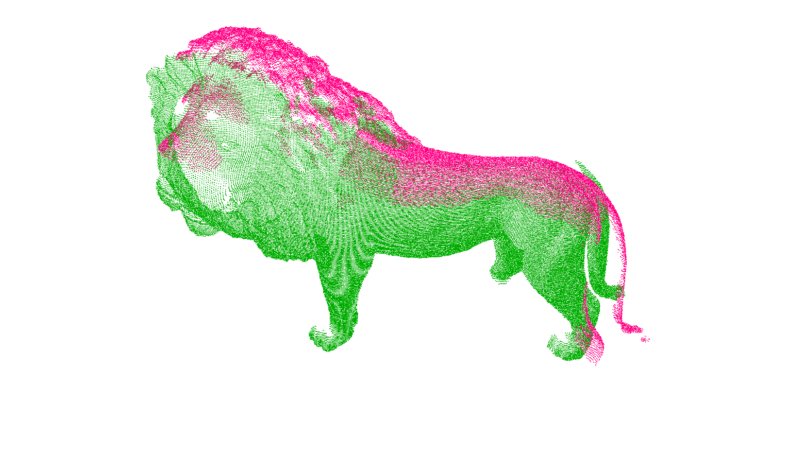
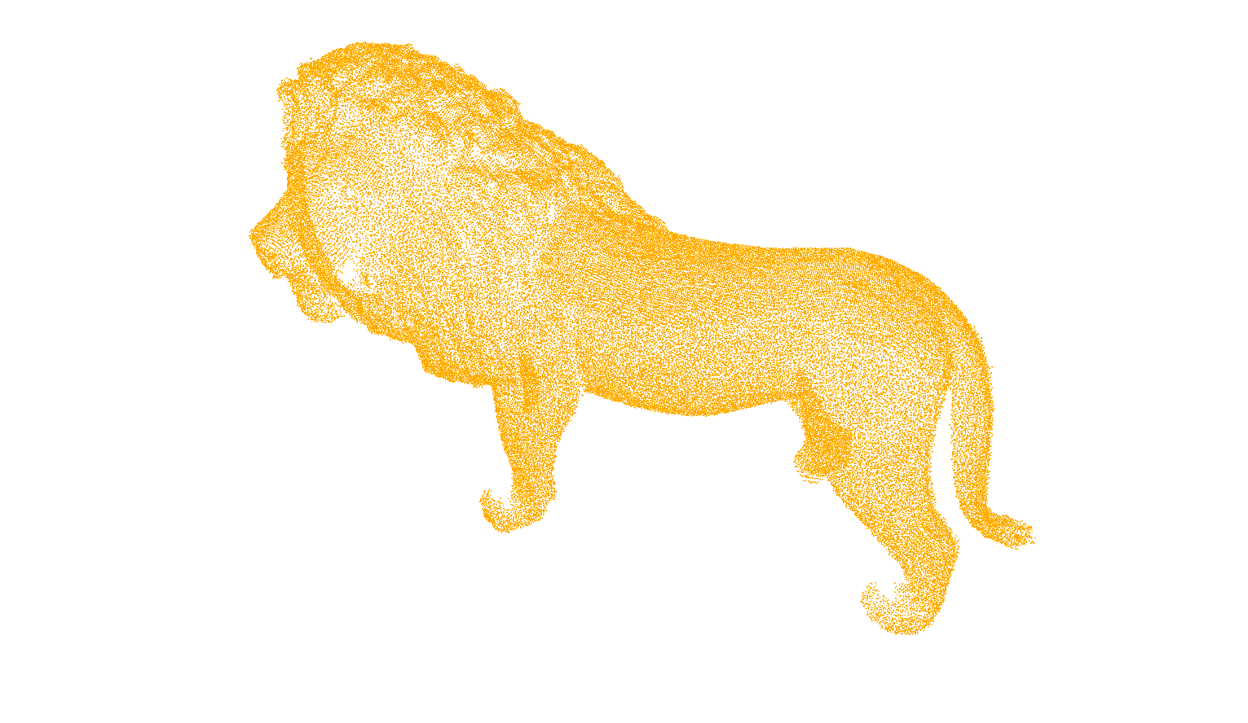
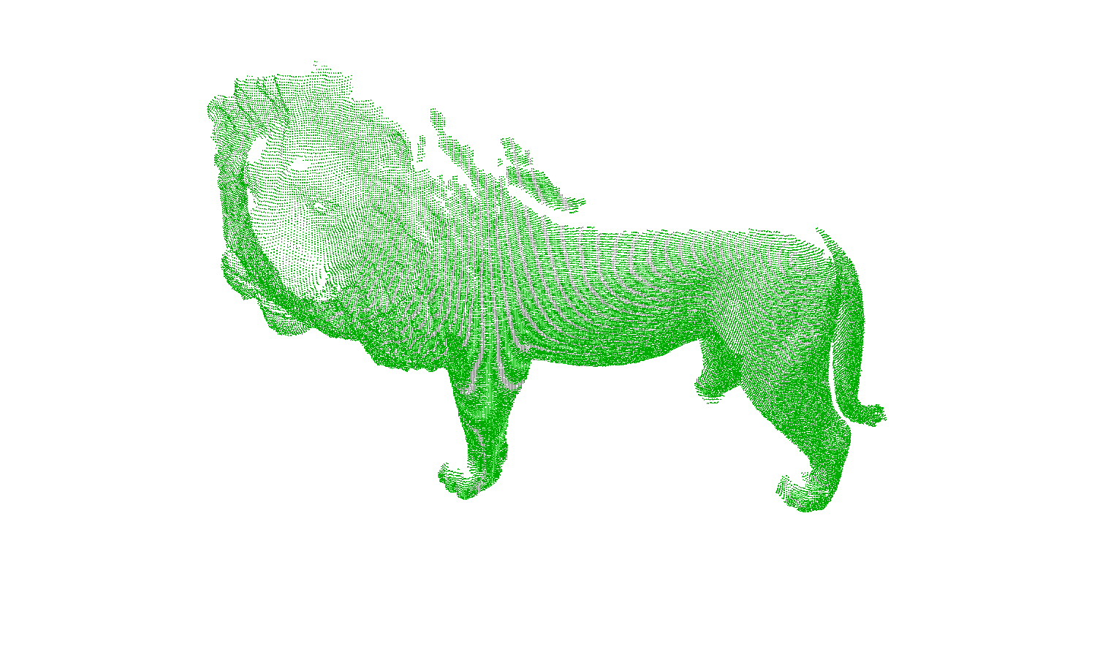
PC Reconstruction and Handling: ICP

Slide 11
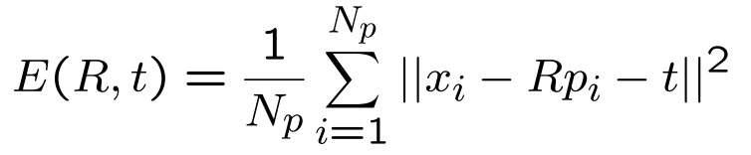
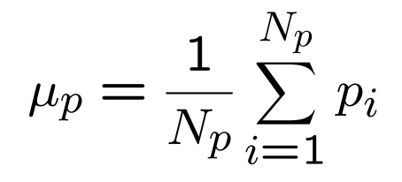
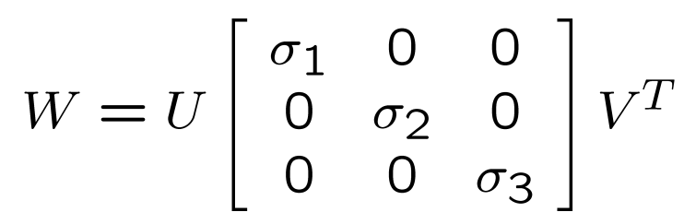
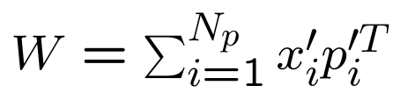
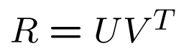
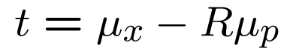
PC Reconstruction and Handling: ICP
Selection of the closest points (Nanoflann)
K-d tree (dim 3)
NN search (nearest neighbour)
Minimization of the error between PC (Eigen)
Center of Mass
SVD Decomposition
Motion application
Notes:
http://ais.informatik.uni-freiburg.de/teaching/ss12/robotics/slides/17-icp.pdf

Slide 12
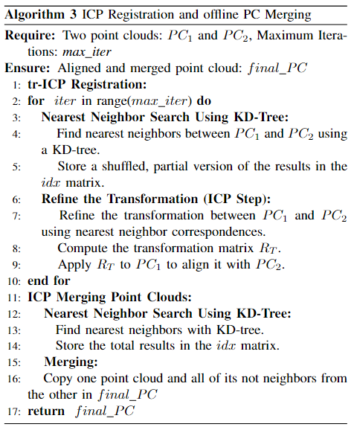
Point cloud merging with ICP
PRO:
Approach based on Eigen and Nanoflann (robust libraries)
Direct manipulation of the point clouds
Correction of misaligned maps
Elimination of “duplicate” points
Creation of direct .ply files
CONS:
Not optimized = time consuming
Not integrated = more steps required

Slide 13
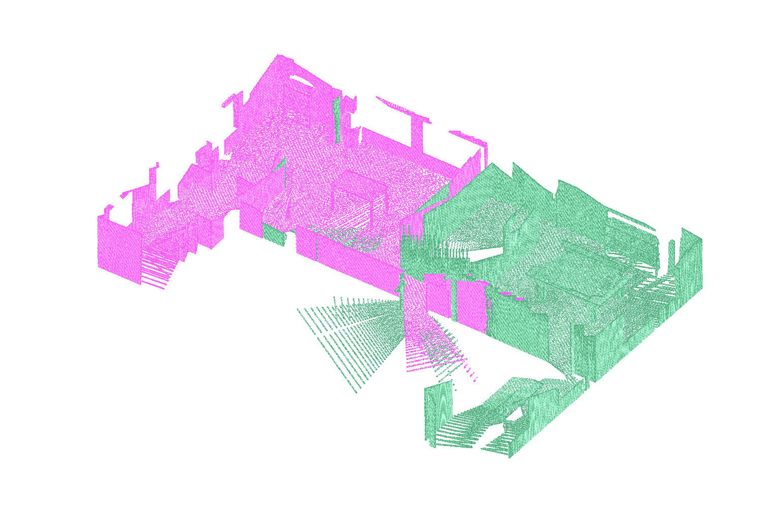
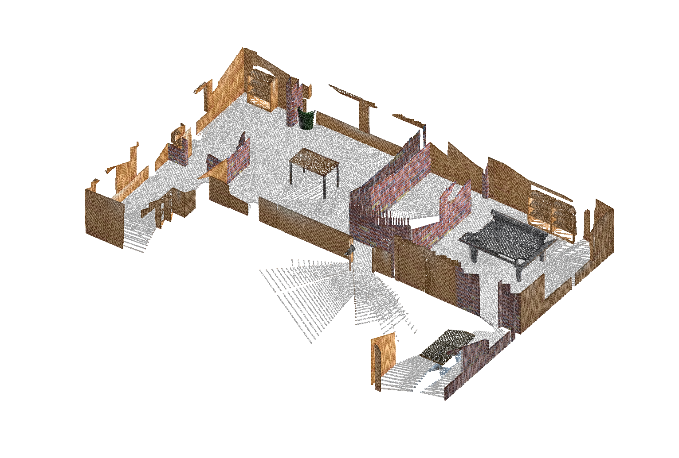
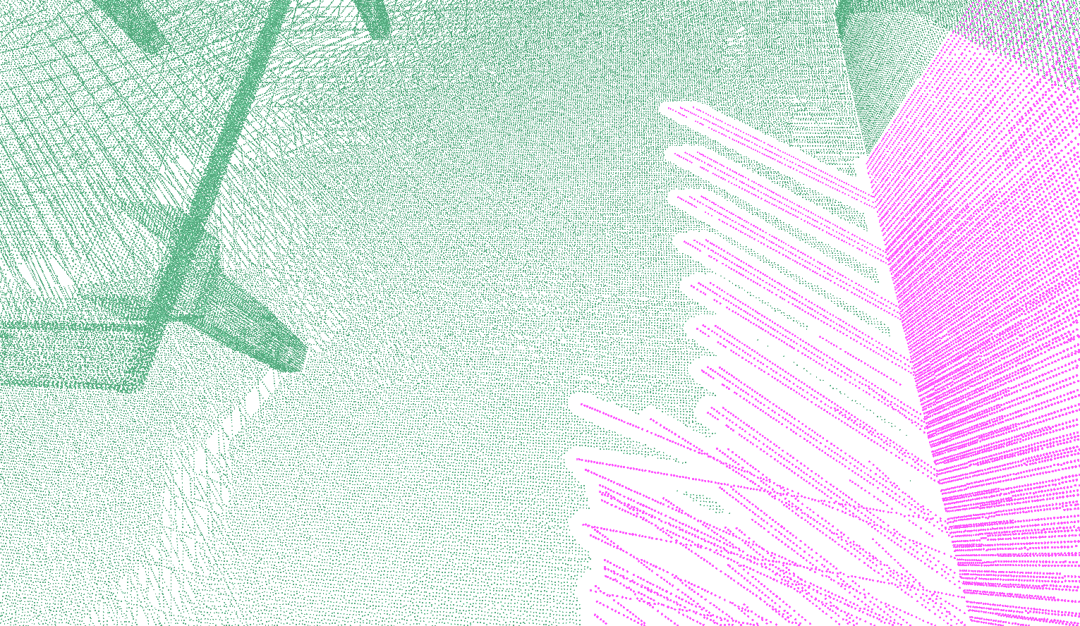
Point cloud merging with ICP

Slide 14
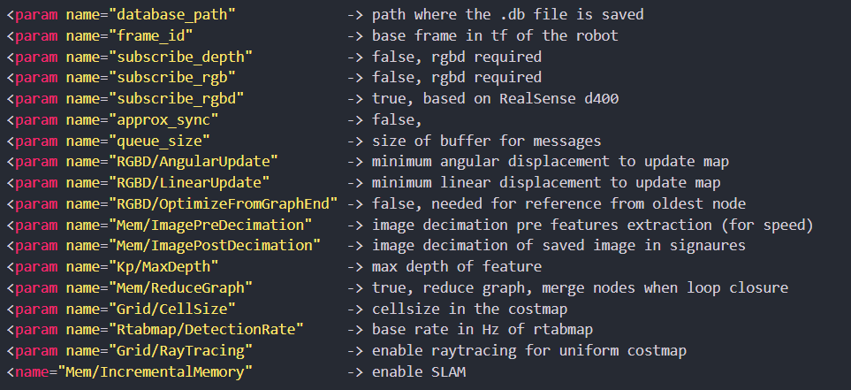

Slide 15
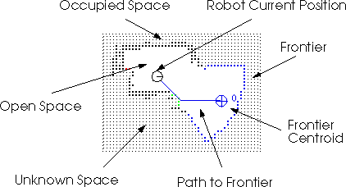
Exploration
Frontier-based exploration allows full autonomy in the navigation process.
No need for waypoints or prior map knowledge.
Two phases:
Frontiers detection;
Allocation to robot fleet.
Notes:
Approccio efficace per problemi di SLAM

Slide 16
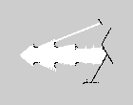
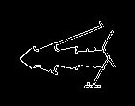
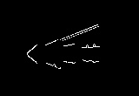
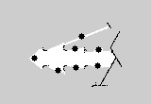
Exploration
Frontier Detection:
SLAM solution returns an occupancy grid. Map is divided in:
Unexplored area.
Explored area, probabilistic binary variable to describe presence of an obstacle.
Converting grid into gray-scale image, computer vision techniques can be used to identify frontiers:
Starting Grid
Edge Detection
Obstacles Filtering
Grid with Frontiers

Slide 17
Exploration
Frontier assignment to the individual robots.
Reward Function for every robot-frontier pair (i, j): R_{ij} = IG_{j} - D_{ij}
IG_{j} : Information gain for that frontier (length of frontier contour).
D_{ij} : Robot-frontier distance.
For every robot, greedy assignment of best frontier (if not already assigned).

Slide 18
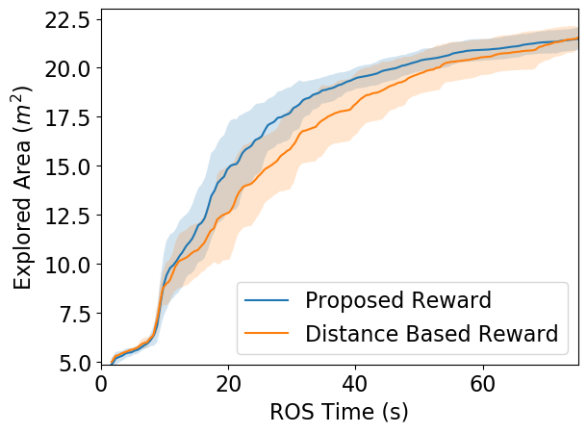
Exploration
Information gain in the reward function promotes exploration of large, unexplored areas.
Robots will cover larger sections of the map faster.

Slide 19
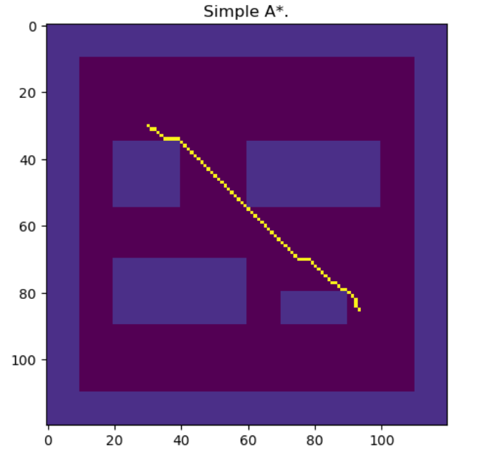
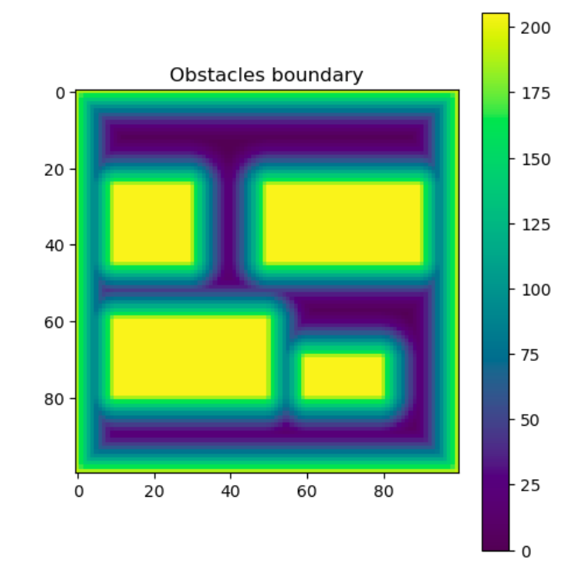
Path Planning
A* star algorithm to approach the frontier centroid.
→ optimal path ignores distance from wall.
Fast-Marching method: efficient simulation of the propagation of a wave until obstacles. → used to create a potential field.

Slide 20
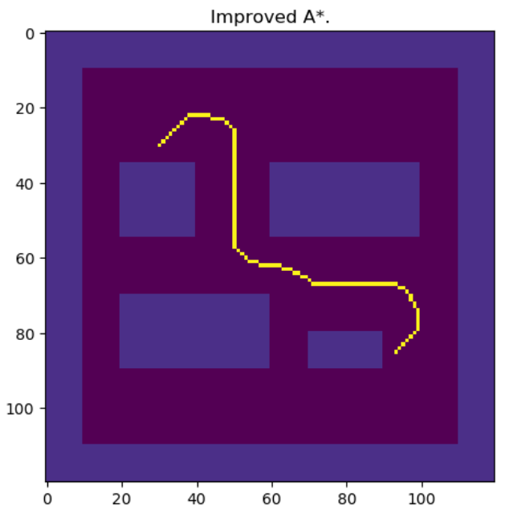

Path Planning
Improved A*: addition of the potential in the algorithm heuristic.
→ Generated path steers clear from walls and obstacles.
Path tracking with simple PID pure-pursuit controller.
Notes:
Cambia con video velocizzato

